Slide 1
Group 6 App demo
Group members :Chenlu Ji, Husam Shakir,
Ruixiong Shi ,Xuan Zuo,
Yusen Wang,

Slide 2
Do you have such problem before?

Slide 3
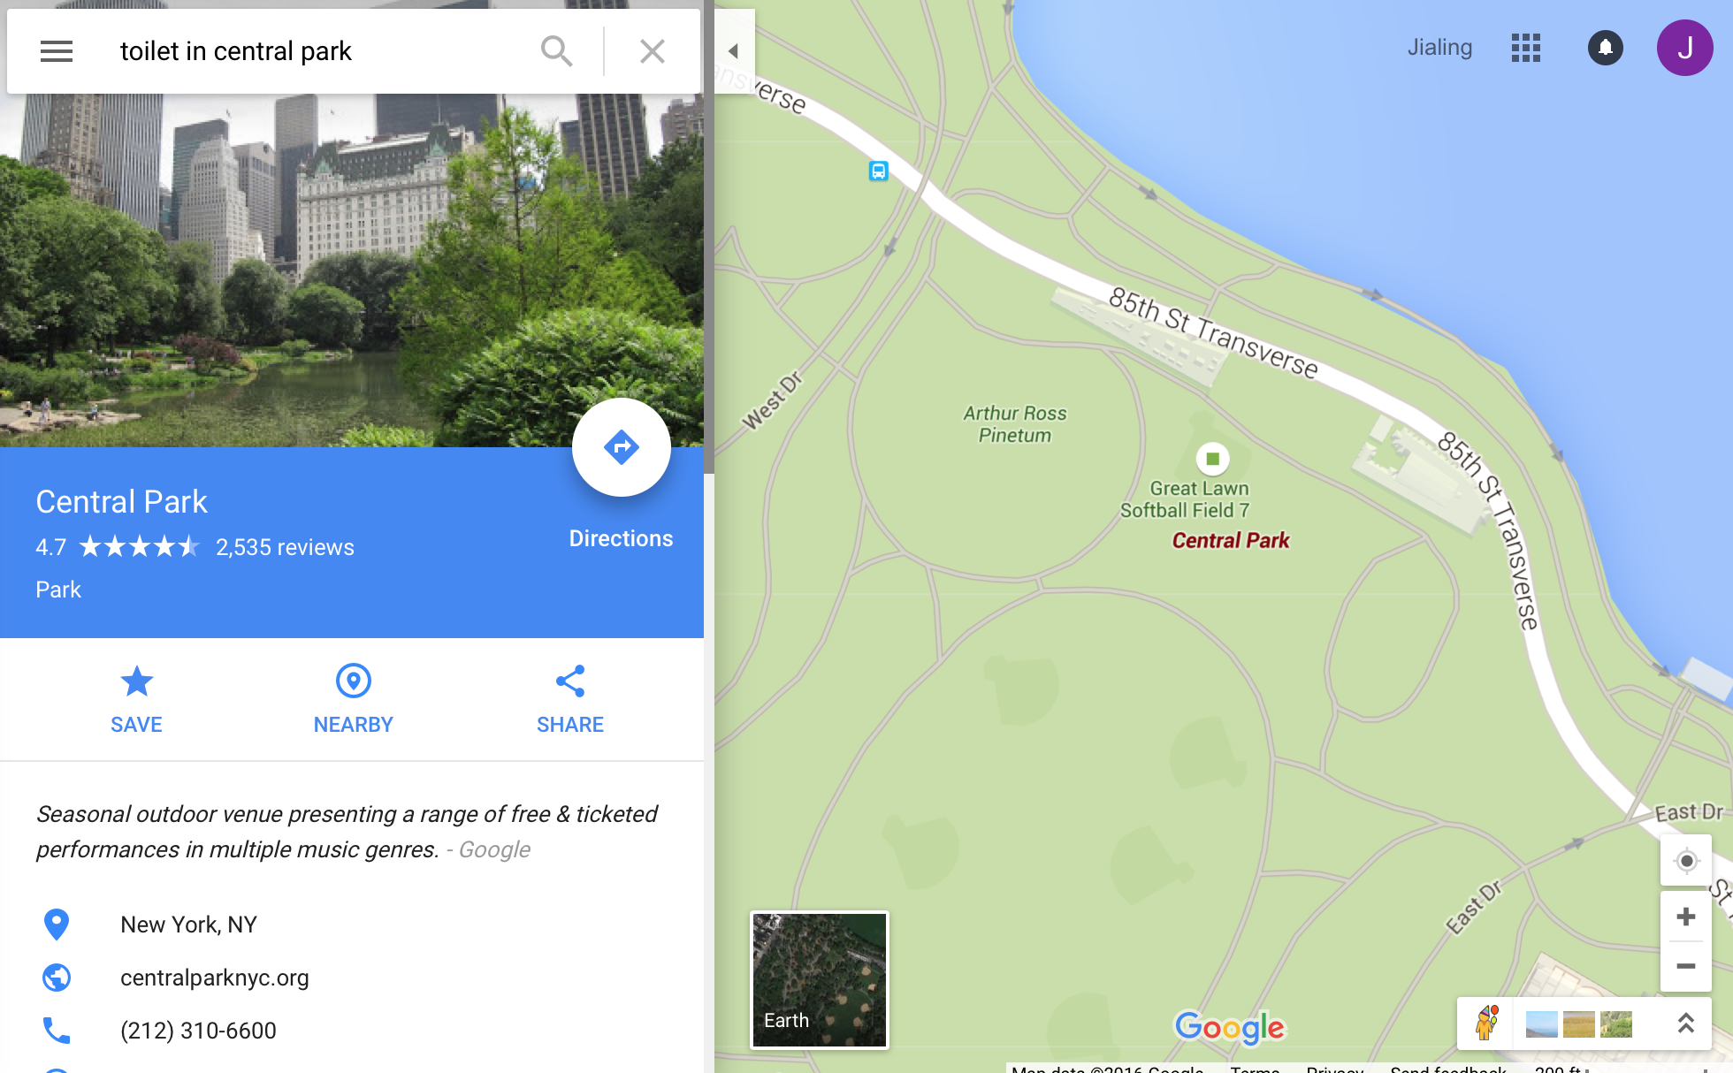
The real world problem
Google map does not tell you exactly the location is.

Slide 4
Real world problem of finding a toilet
1, The guy who know where the toilet is may not as smart as Google
2,

Slide 5
What we are looking for:
A bowl-shaped device with a seat that you sit on or stand near when emptying the body of urine or solid waste, or another device used for this purpose
-----------By Cambridge dictionary
that is free for entry.

Slide 6

Here is our solution:
A new generation of powerful shiny product that allows you:
See all the public toilets around you
Plan your route to the destination
Visualizing possible crimes around

Slide 7
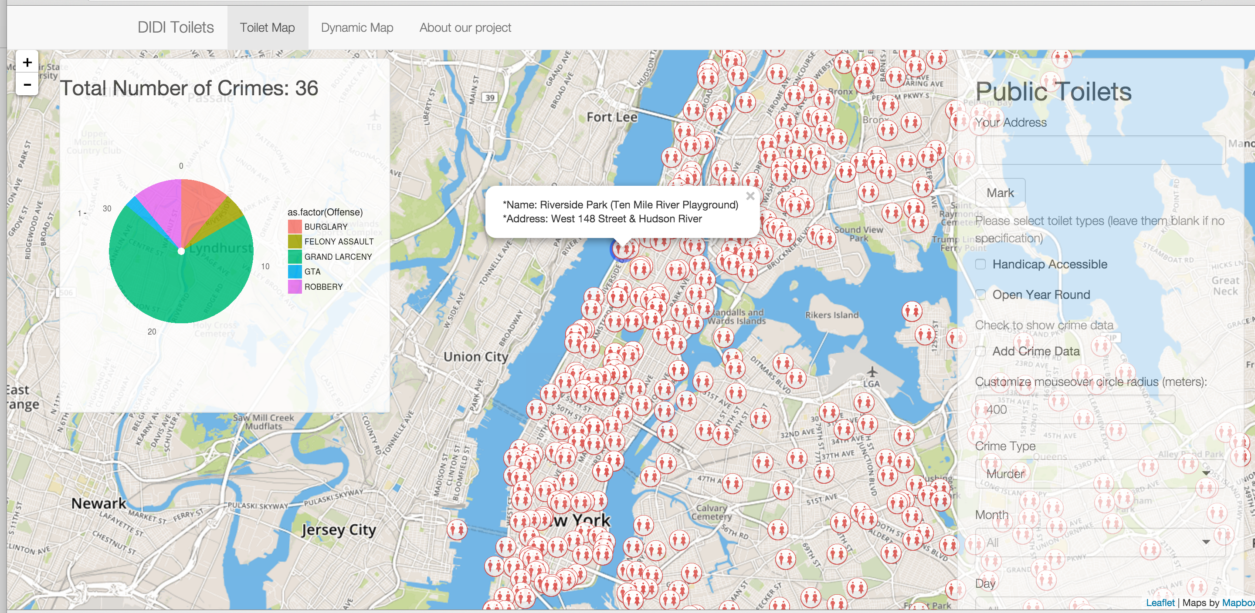

Slide 8
NY restrooms
Directory of public park with toilet in NYC Open data
NYPD 7 felony from 2014 to present
650 restrooms marked as public
76000+ crime data
618 public toilet in parks
668 toilet used in our product

Slide 9
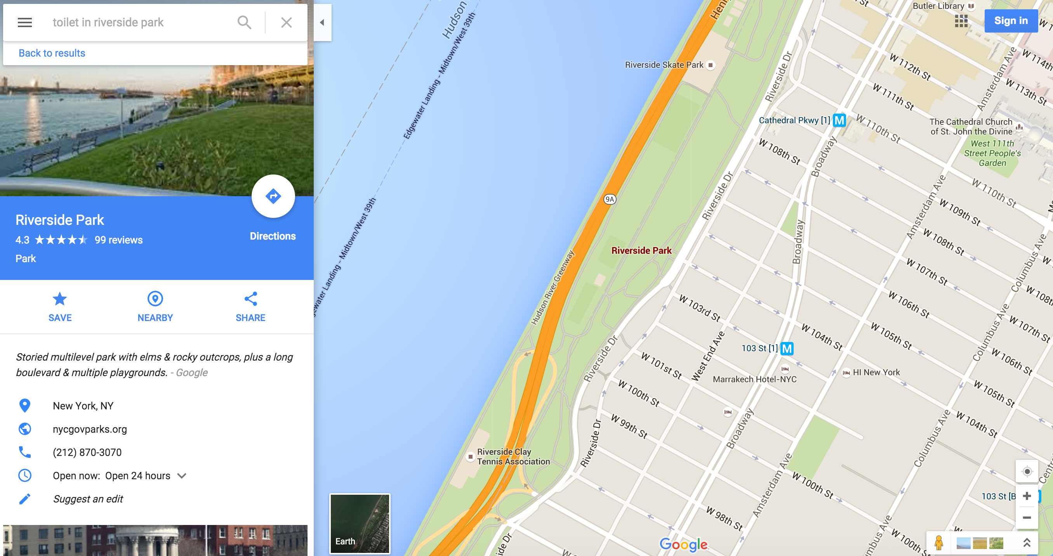
How we beat Google

Slide 10
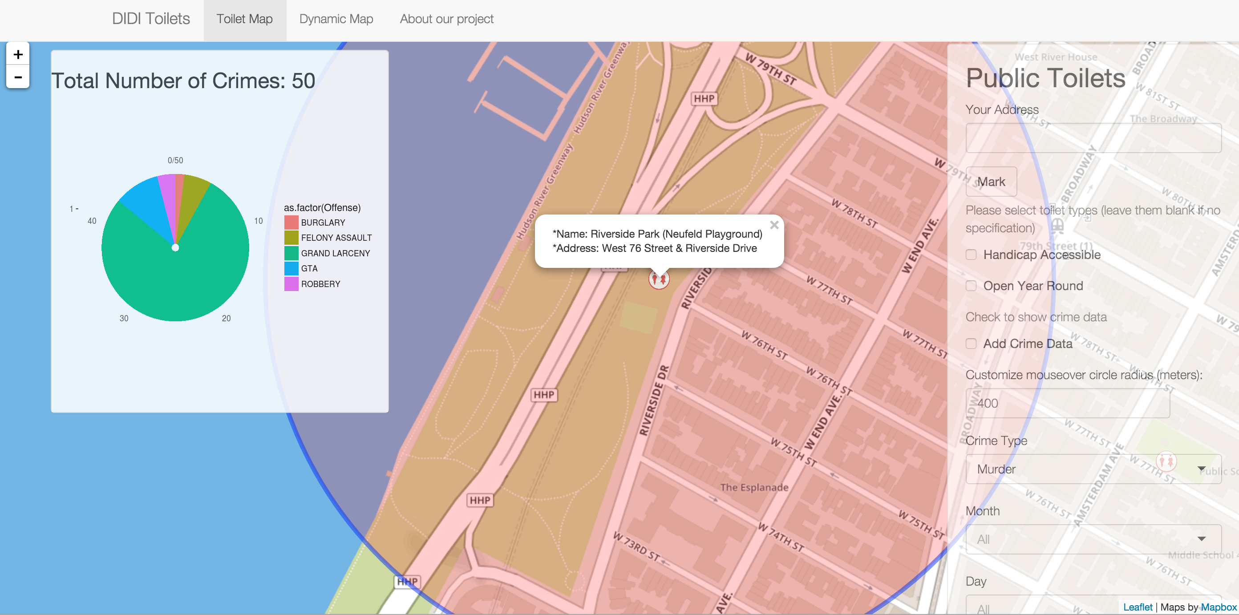

Slide 11
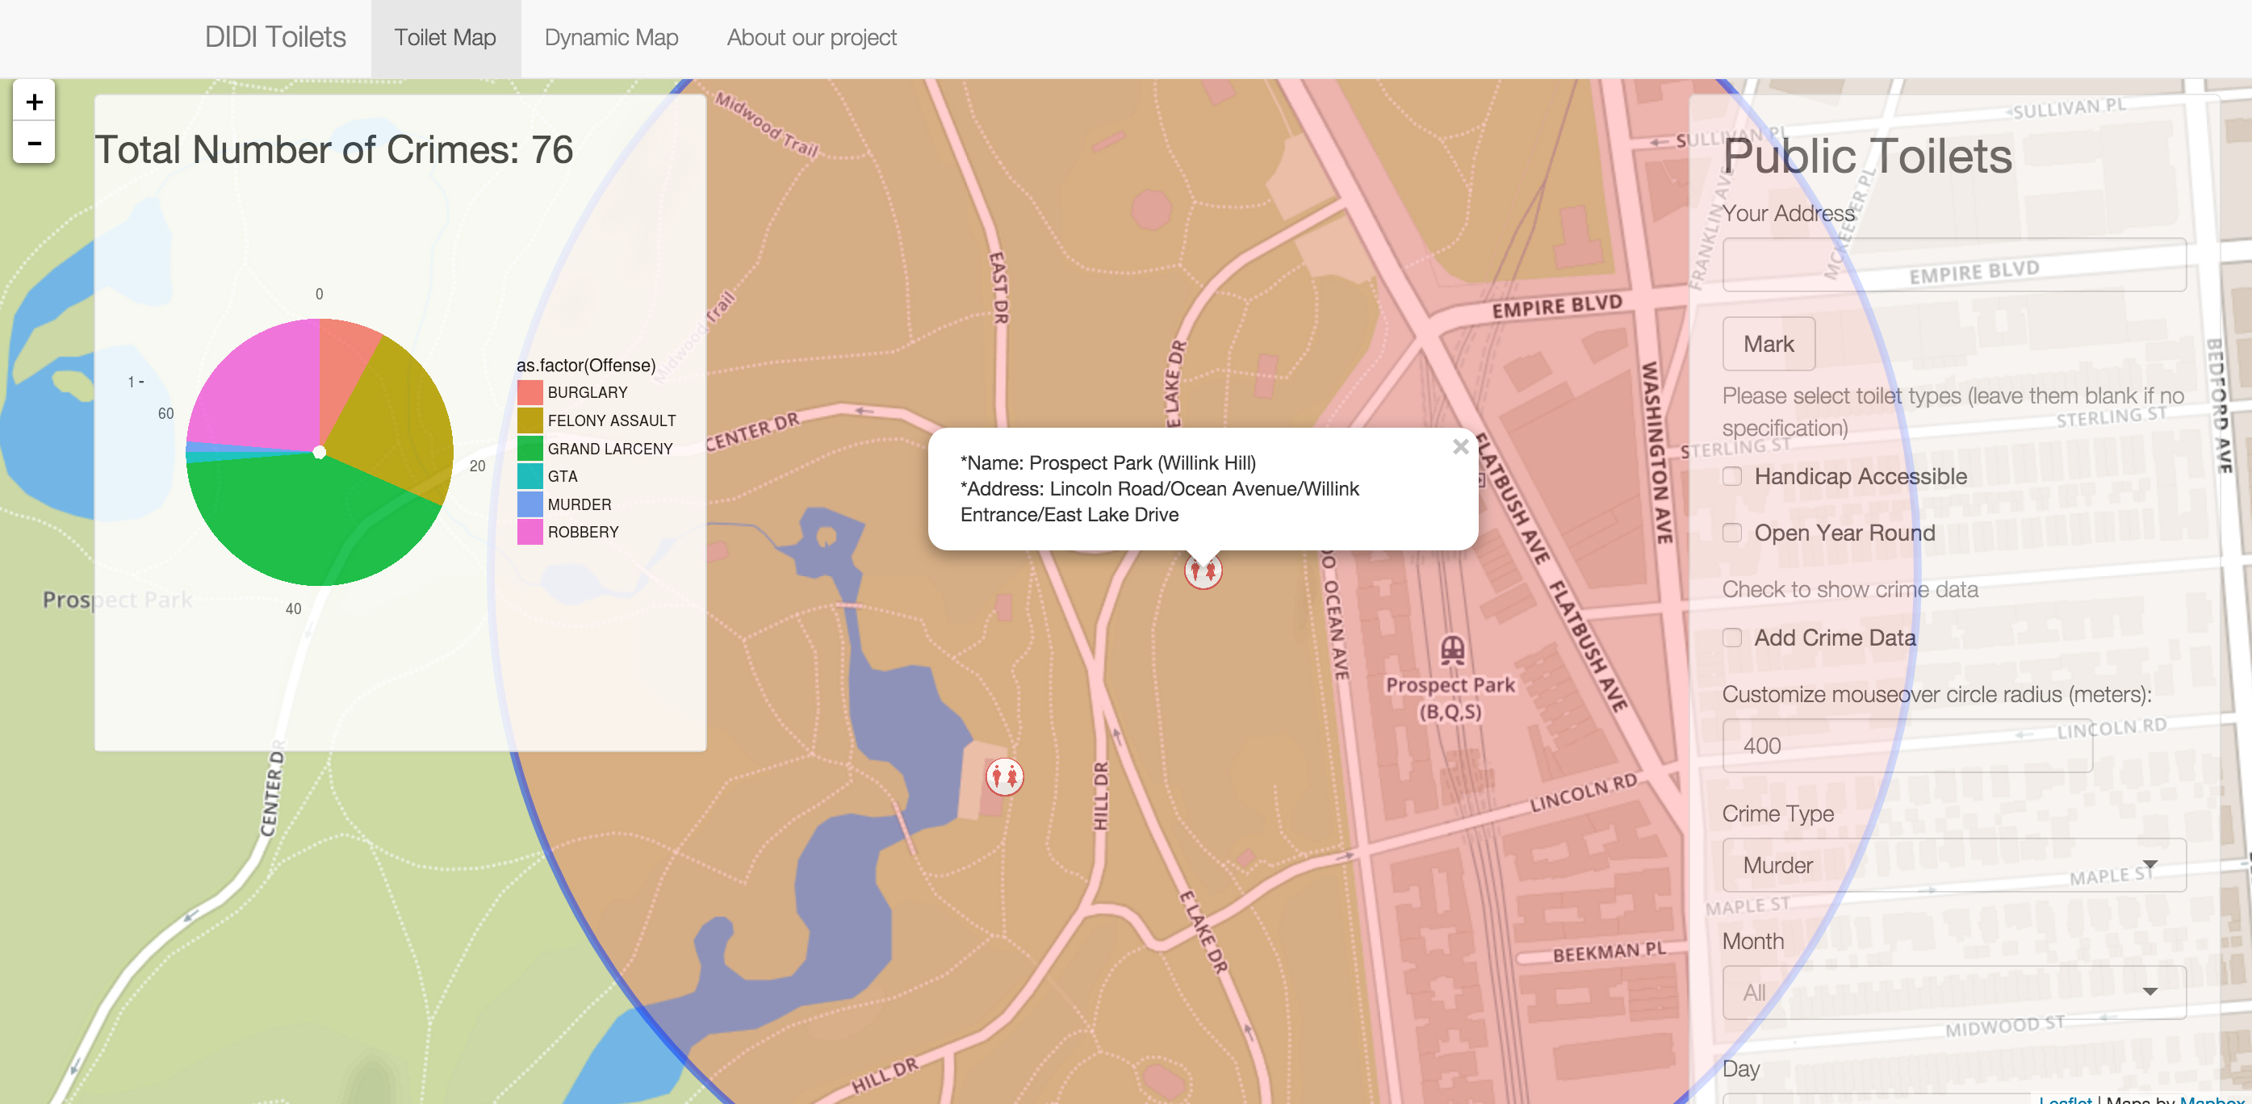

Slide 12
Demo
https://github.com/TZstatsADS/project2-group6/

